Slide 1

Solar Generation Prediction for High Growth Areas
W205 Project Proposal
Amanda Ayles, Vincent Chu, Elizabeth Shulok
Notes:
Vincent

Slide 2
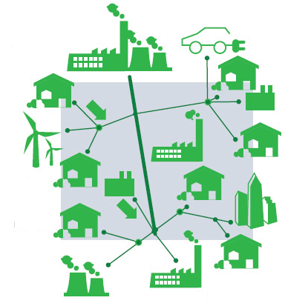
Research Question
How to help utilities focus grid modernization efforts on high growth areas for solar PV and accurately size the impact from reverse power flows?
Notes:
Vincent:
Think about what question or problem are you trying to solve?
Why is this hard or interesting?

Slide 3


Project Description
Why is Growth in Solar of Interest to Utilities?
Solar PV has grown from < 1 GW installed capacity in 2006 to ~25 GW in 2015
Aggressive renewable plans (e.g. 50% renewable by 2030 in CA)
Aging infrastructure not built to support Distributed Generation
Challenges Faced by Utilities
Predictive model for new solar installations not granular enough to prioritize grid modernization efforts by geographic areas
Cannot accurately predict amount of power generation due to variation caused by irradiance and local shading effects
Notes:
Vincent

Slide 4

Scope
Geographic Focus: California
Ranked 1st in US in installed capacity: 3,266 MW (end of in 2015)
Public data readily available due to state-sponsored incentives
Goals
Identify high growth areas for solar adoption using factors such as irradiance, household income, political affiliation, etc.
Predict amount of solar generation by modeling effect of local shading on output capacity of solar panels
Notes:
Liz

Slide 5






Target Audience
California Utilities
Need to increase PV hosting capacity
Use our model to plan grid modernization work
Solar Installers
Identify target markets for PV installation
Notes:
Liz

Slide 6




Data Approach
Collection
Ingestion
Transformation & Conditioning
Modeling
Finalize data sources
Validate data sets against variables needed for model
Create scripts to load data into HDFS data lake, with different frequencies, e.g., weekly for solar generation data, monthly for income , etc.
Normalize income data to per household / head
Aggregate solar generation over period of time
Estimate expected solar generation with no local shading
Build regression models to predict solar adoption and corresponding generation level
Notes:
Vincent:
High level, how do you anticipated the data flow?
What types of queries/data access will you need at each stage?
How are you applying the concepts so far to your project?

Slide 7

Data Sets
Solar Irradiance
National Solar Radiation Data Base provided by the National Renewable Energy Laboratory
Measured Production Energy Set provided by California Solar Statistics
Public Policy Institute of California
Pew Research Center
Financial
(e.g., Household Income)
Personal Factors
(e.g., political Affiliation)
Solar Panel Energy Production
Notes:
Amanda:
What data could you possibly use?
We started to brainstorm:
- Solar Radiation
- Solar Panel Energy Production
- ‘Census’ data - family income, size of household, political affiliation
What data can you get?
So far we have found some great data sets like:

Slide 8

Challenges & Open Questions
Variety - Our research question is going to need to bring a lot of disparate data sets together in order to tell the full story that we’re looking for
Specific concerns at this point:
Finding overlapping dates to get everything on the same playing field
Access to data that is at a granular enough level to achieve our goals
Developing a prediction measure that would be applicable to the end user
Notes:
Amanda:
Challenges:
What open questions do you still have?
What information organization challenges do you face?
We will need to handle a lot of cleaning and organizing the data into a useable format.

